Slide 1
Soft Tissue Modelling for Orthopedic Surgery
K. Simmonds, F. Heimann, A. Contri, U. Schaarschmidt, V. Raveendran, S. Nepal, A. Massing, N. Avery ,
With assistance from problem setters B. Rasheed and H.G. Schaathun

Slide 2
Agenda
Introduction
Considerations
Simple Case
Topic four
Topic five

Slide 3

Introduction Vision
Simulator training for surgeons is increasingly important. While simulators for basic skill training have already been deployed, they have insufficient fidelity to train experienced surgeons in particular and advanced procedures.

Slide 4
Introduction Problem
One of the problems to solve is dynamic modelling of soft tissue to allow simulation of deformation, tear, and cutting as will arise in surgical procedures.

Slide 5
Introduction Challenge
Soft-tissue deformation is readily simulated in mesh models, governed by differential equations which are solluble by finite element modelling.
However, tear (cutting) introduces discrete events, changing the topology of the mesh. This is known to be computationally hard.

Slide 6

Considerations

Slide 7
Considerations
Wish to have a real time solutions
What is the material like
linear elatic or hyper elastic?
3 dimenstional?
What is the shape?
Are there hard boundaries like bone?
isotropic or fibrous?
What method of cutting should we use?
Does insertion of the knife cause damage

Slide 8

Simple Case : Assumptions
2 Dimensional
Static
Linear elastic
Isotropic
Beam shape with holes cut

Slide 9
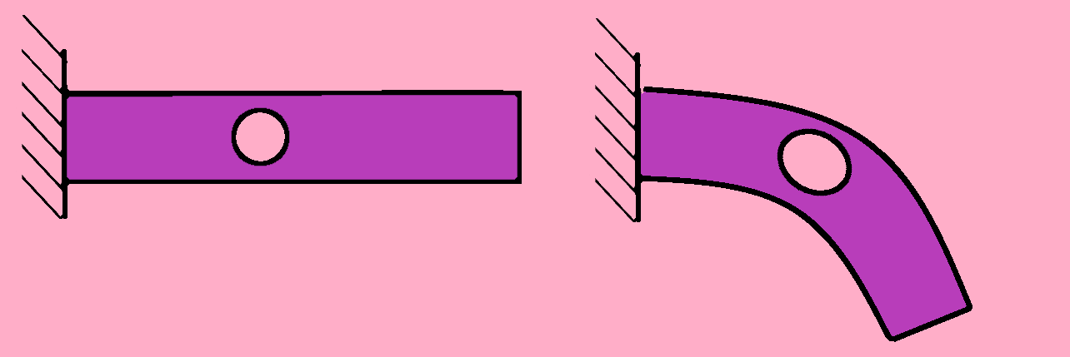
Simple Case : Formulation
The idea is to model the static deformation of the case above using a finite element method.

Slide 10
Simple Case: Finite Element Method (FEM)
Numerical method for solving partial differential equations (PDE)
Simplify the space by constructing of a mesh of the object
Derive the weak formulation of the PDE.
Calculate the weak formulation for each element in the mesh (using a solver)

Slide 11
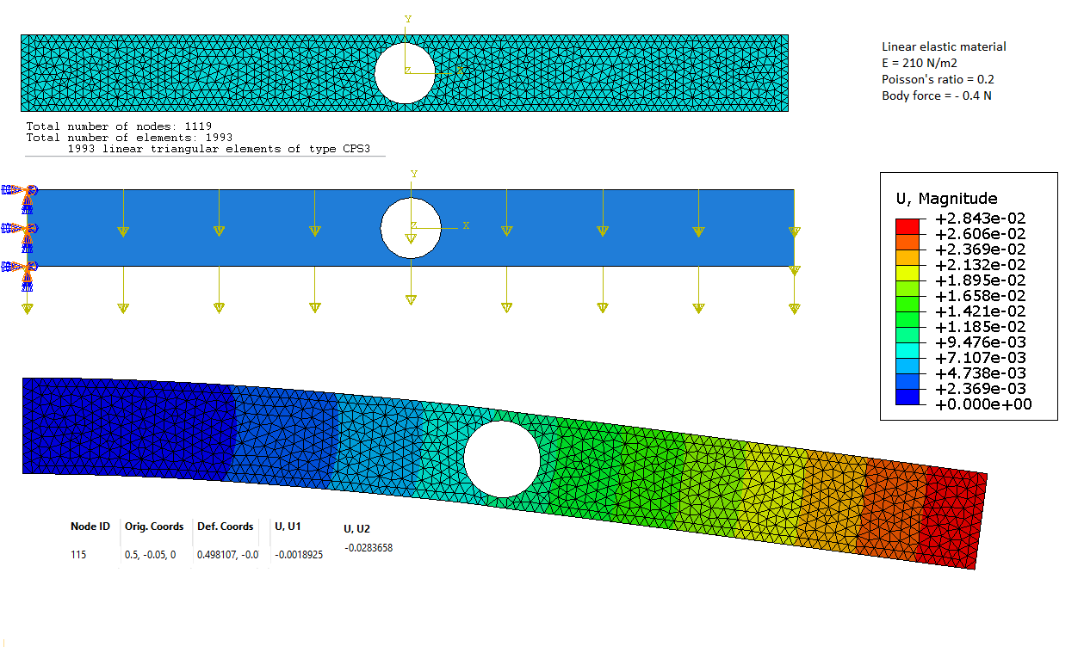
Simple Case : Solution in Abacus

